Slide 1
History and forecast of climate change
Kevin Law, Ph.D.
WV State Climatologist
Marshall University

Slide 2
Mean Annual Temperature (°F) 1981-2010
56°F-60°F Charleston-Huntington
51°F-55°F Wheeling
Morgantown
Parkersburg
Martinsburg
Beckley
46°F-50°F Elkins

Slide 3
Mean Annual Precipitation (inches) 1981-2010
Range: Approx. 30” – 60”
Low: Near Moorefield (Hardy Co.)
High: Near Pickens (Randolph Co.)
Most of the state 40”-50”

Slide 4
Mean Annual Temperature (°F) West Virginia 1895-2012
1971-2000 Mean: 51.8°F
“Warm period” 1930-1956
“Cool period” 1957-1981
“Warm period” 1987-present
1921, 1949 Warmest years
4 of 6 warmest years have occurred since 1990
2012
1998
1990
1991

Slide 5
Total Annual precipitation (inches) west Virginia 1895-2012
1971-2000 Mean: 45.16”
1930 Drought year 25.74”
“Dry period” 1960s
Increased precipitation trend
5 of the 6 wettest years have occurred since 1989
2003
1996
2004
1972
2011
1989

Slide 6
Annual Heating degree days (base 65°f) west Virginia 1895-2012
1971-2000 Mean: 5296 HDD
Decreasing trend in HDD
Less demand for energy for heating

Slide 7
Annual cooling degree days (base 65°f) west Virginia 1895-2012
1971-2000 Mean: 771 CDD
Increasing trend in CDD
Increased demand for energy for cooling

Slide 8
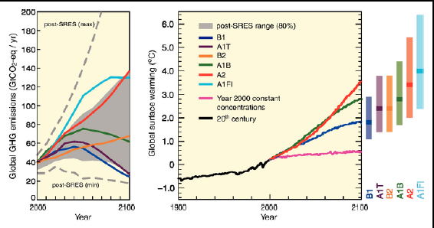
Future climate scenarios
Simulations use high (A2) and low (B1) emission scenarios
Simulations are intended as scenarios not forecasts because there are no assumptions about the probability of either scenario occurring.

Slide 9
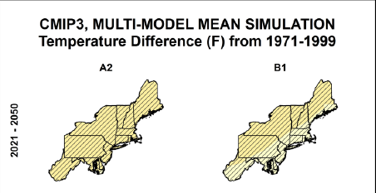
Mean Temperature Difference (°F) 1971-1999
B1 (low)
2035: ~2.0°F warming
2055: ~3.0°F warming
2085: ~4.0°F warming
A2 (high)
2035: ~3.0°F warming
2055: ~5.0°F warming
2085: ~7.0°F warming

Slide 10
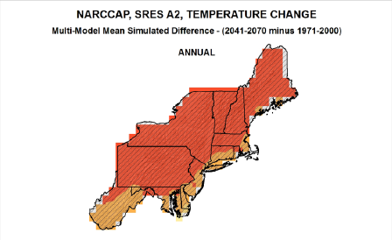
Temperature change (°F) 2041-2071 minus 1971-2000
Annual: ~5.0°F warming
Winter: ~4.0°F warming
Spring: ~3.0°F warming (least)
Summer: ~5.5°F warming (greatest)
Fall: ~5.0°F warming

Slide 11
Annual Number of Days T_{max} > 95°F
Climatology: 0-10 days per year
2055: 5-30 days per year
Most change is in SW West Virginia

Slide 12
Annual Maximum number of consecutive days T_{max} > 95°F
Climatology: 0-2 days per year
2055: 3-9 days per year
Most change in SW West Virginia

Slide 13
Annual total cooling degree days
Climatology: 0-900 days per year
2055: 600-1500 days per year

Slide 14
Annual Number of Days T_{min} < 10°F
Climatology: 0-20 days per year
2055: 0-10 days per year
Northern mountains exhibit most change in West Virginia

Slide 15
Annual Number of Days T_{min} < 32°F
Climatology: 100-150 days per year
2055: 75-125 days per year
Most change in SW West Virginia

Slide 16
Annual total heating degree days
Climatology: 5000-7000 days per year
2055: 4000-6000 days per year
West Virginia mountains exhibit large decrease

Slide 17
Length of freeze-free season
Climatology: 80-160 days per year
2055: 120-160 days per year
Approx. 23-29 day increase

Slide 18
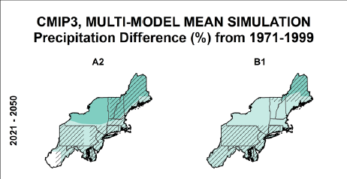
Precipitation difference (%) from 1971-1999
B1 (low)
2035: 0-3% increase
2055: 0-3% increase
2085: 3-6% increase
A2 (high)
2035: 0-3% increase
2055: 0-6% increase
2085: 0-6% increase

Slide 19
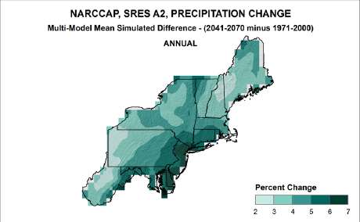
Precipitation change (%) 2041-2070 minus 1971-2000
Annual: 2-7% increase
Winter: 8-20% increase
Spring: 4-12% increase
Summer: 0-12% decrease
Fall: 4% decrease – 4% increase

Slide 20
Annual number of days Precipitation > 1 inch
Climatology: 7-11 days per year
2055: 18-24% change

Slide 21
Maximum consecutive number of days precipitation < 3mm
Climatology: 21-30 days per year
2055: 0-2 days more per year

Slide 22
conclusions
Increased trend in CDD
More energy demand for Air Conditioning
Decreasing trend in HDD
Less energy demand for Heating
More variability in precipitation
Wetter in winter – Drier in summer
Hotter and drier conditions in summer
Can lead to more severe convective storms
Storm related power outages

